Slide 1
PACKAGES
Packages are java’s way of grouping related classes and/or interfaces together.
The grouping is done according to the functionality.
Packages act as “CONTAINERS” for classes.

Slide 2
ADVANTAGE OF PACKAGES
Two classes in two different packages can have the same name.They may be referred by their fully qualified name, comprising the package name and class name.

Slide 3
Packages provide a way to “hide” classes thus preventing other programs or packages from accessing classes that are meant for internal use only.
Packages also provide a way for separating “design” from “coding”.first we can design classes and decide their relationships, and then we can implement the Java code needed for the methods.It is also possible to change the implementation of any method without affecting the rest of the design.

Slide 4
FREQUENTLY USED JAVA API PACKAGES
Java
lang
applet
util
io
awt
net

Slide 5
CREATING PACKAGES
Declare the package at the beginning of a file using the form :
package packagename;
The package statement, if present, should be the first statement in the java source file.
Create a directory named packagename and put the file classname.java in it.
Go to the directory packagename and compile the file classname.java.

Slide 6
package package1; // package declaration
class Class1; // class definition
{
……………….
………………. (body of the class)
……………….
}
Here Class1.java and Class1.class will be saved in the directory package1.

Slide 7
Java also supports the concept of package hierarchy.
This is done by the following statement :
package firstpackage.secondpackage;
This package will be stored in a subdirectory named firstpackage\secondpackage.
For example, a package declared as
package java.awt.image;
Needs to be stored in the java\awt\image directory.
You cannot rename a package without renaming the directory in which the classes are stored.

Slide 8
ACCESSING A PACKAGE
The import statement is used to search a list of packages for a particular class.
The general form of import statement is :
import package1.[.package2] [package3].classname;
example :
import firstpackage.secondpackage.MyClass;
After defining this statement, all the members of the class MyClass can be directly accessed using the class name or its objects(as the case may be) directly without using the package name.

Slide 9
// A simple package Example
package MyPack;
class Balance {
String name;
double bal;
Balance(String n, double b) {
name = n;
bal = b;
}

Slide 10
Contd..
void show() {
if(bal<0)
System.out.print("-->> ");
System.out.println(name + ": $" + bal);
} }
class AccountBalance {
public static void main(String args[]) {
Balance current[] = new Balance[3];

Slide 11
Contd..
current[0] = new Balance("K. J. Fielding", 123.23);
current[1] = new Balance("Will Tell", 157.02);
current[2] = new Balance("Tom Jackson", -12.33);
for(int i=0; i<3; i++) current[i].show();
}
}

Slide 12
Contd..
This file will be saved as AccountBalance.java and put in the directory MyPack
Suppose MyPack is in the directory c:\java .
Go to c:\java\MyPack and compile AccountBalance.java
Both the .java and .class files will be put in the MyPack directory.
The program will be run as :
java MyPack.AccountBalance
Remember, you will need to be in the directory above MyPack when you execute this command.

Slide 13
There are two ways to run the program
  Go to the directory c:\java and run the program by writing the following statement on the command line.
  C:\Java>java MyPack.AccountBalance
  Put c:\java in your classpath. By this method you can run the program from anywhere (even from a different drive such as D:\) by writing the following statement on the command line.
  D:\>java MyPack.AccountBalance

Slide 14
Output:
K. J. Fielding: $123.23
Will Tell: $157.02
-->> Tom Jackson: $-12.33

Slide 15
Understanding import
import java.util.*;
class MyClass extends Date
{
}
/* At any place you use a class name, you can use its fully qualified name, which includes its full package hierarchy.*/
The above example WITHOUT import statement looks like this:
class MyClass extends java.util.Date
{
}

Slide 16
The star(*) form may increase the compilation-time – especially if you import several large packages.
For this reason, it is a good idea to explicitly name the classes that you want to use rather than importing whole packages.
Suppose we need only the Date class of the java.util package in our program, we can use the statement import java.util.Date; instead of import java.util.*;

Slide 17
IMPORTANT
When we have nesting of packages like (package p1.p11.p111;), then importing a package like (import p1.*;) will include all the classes of the package p1 only and NOT the classes of its subpackages.
In order to use the classes of subpackages, it is required to import those subpackages also.

Slide 18
/*
Write the following code in file Testp1.java and save it in suppose C:\Java\p1
*/
package p1;
public class Testp1
{
public static void funp1()
{
System.out.println("In funp1() at c:\\java\\p1");
}
}

Slide 19
/*
Write the following code in file Testp11.java and save it in C:\Java\p1\p11
*/
package p1.p11;
public class Testp11
{
public static void funp11()
{
System.out.println("In funp11() at c:\\java\\p1\\p11");
}
}

Slide 20
/*
Write the following code in file Testp111.java and save it in C:\Java\p1\p11\p111
*/
package p1.p11.p111;
public class Testp111
{
public static void funp111()
{
System.out.println("In funp111() at c:\\java\\p1\\p11\\p111");
}
}

Slide 21
/* Write the following code in TestPackage.java and save it in c:\Java */
import p1.*;
import p1.p11.*;
import p1.p11.p111.*;
public class TestPackage
{
public static void main(String args[])
{
System.out.println("In main() at c:\\java");
Testp1.funp1();
Testp11.funp11();
Testp111.funp111();
}
}

Slide 22
Output:
C:\Java>java TestPackage
In main() at c:\java
In funp1() at c:\java\p1
In funp11() at c:\java\p1\p11
In funp111() at c:\java\p1\p11\p111
If there had been a main() in Testp111.java, then it can be invoked by the following command:
C:\Java>java p1.p11.p111.Testp111

Slide 23
REMEMBER
If we save the file TestPackage.java in some directory other than c:\java, it will not compile.
But if we put the c:\java directory (i.e. the directory containing all the packages and subpackages - p1,p11,p1111) in our classpath, then we can save the TestPackage.java file any where, even in some other drive like d:\ or e:\ and get it compiled and run successfully from that location.
So, its always better to put the top-level directory in the classpath when you are working in multiple packages.

Slide 24
All the classes and the methods that need to be accessed from other packages, should be declared public.
Declaring a class as public, doesn’t implicitly declare its members public.
We need to explicitly declare them public, if we want them to be accessed from other packages.

Slide 25
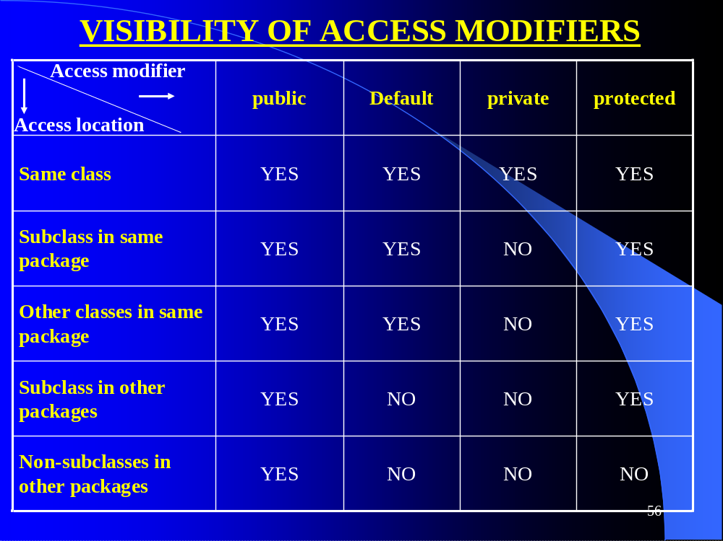

Slide 26
REMEMBER
When a package is imported, only those items within the package declared public will be available to non-subclasses in the importing code.
Non-static protected members of a class in one package can be accessed in its subclasses in other packages by an instance of the subclass ONLY.
They can NOT be accessed by an instance of the superclass.

Slide 27
// this file is ProTest .java in c:\java\p1
package p1;
public class ProTest
{
protected int i = 3;
protected static int j= 4;
protected static void staticPrint( )
{
System.out.println("in staticPrint( ) of p1. ProTest ");
}
protected void nonstaticPrint( )
{
System.out.println("in nonstaticPrint() of p1. ProTest ");
}
}

Slide 28
package p2; // this file is ProTest .java in c:\java\p2
//import p1.*;
class ProTest extends p1.ProTest // 1
//we can create same class-name files in different packages
{
public static void main(String args[])
{ p1.ProTest ob1= new p1.ProTest (); // 2
ProTest ob2 = new ProTest ();
System.out.println(“p1.j = " + j);
/*staticPrint() can be accessed directly by its name only or by ob1 or ob2 or by p1.ProTest.staticPrint() */
ob1.staticPrint();
/* non-static protected members are accessed by subclass instance only */
System.out.println(“p1.i = " + ob2.i);
ob2.nonstaticPrint();
}
}

Slide 29
/*
Put c:\java in your classpath and then run the program from anywhere like the following:
*/
Output
C:\>java p2.ProTest
p1.j = 4
in staticPrint( ) of p1.ProTest
p1.i = 3
in nonstaticPrint() of p1.ProTest
D:\>java p2.ProTest
p1.j = 4
in staticPrint( ) of p1.ProTest
p1.i = 3
in nonstaticPrint() of p1.ProTest

Slide 30
package p2; // this file is ProTest1 .java in c:\java\p2
import p1.*; // Using import statement now
class ProTest1 extends ProTest // 1
{
public static void main(String args[])
{
ProTest ob1= new ProTest (); // 2
ProTest1 ob2 = new ProTest1 ();
System.out.println("p1.j = " + j);
/*staticPrint() can be accessed directly by its name only or by ob1 or ob2 or by p1.ProTest.staticPrint()*/
ob1.staticPrint();
/* non-static protected members are accessed by subclass instance only */
System.out.println("p1.i = " + ob2.i);
ob2.nonstaticPrint();
}
}

Slide 31
INTERFACES
Using the keyword interface, we can fully abstract a class interface from its implementation.
Using interface, we specify what a class must do, but not how it does it.
Interfaces are syntactically similar to classes
They lack instance variables and their methods are declared without any body.
Once it is defined, any number of classes can implement an interface.
One class can implement any number of interfaces.

Slide 32
DEFINING AN INTERFACE
access interface name{
return type method-name1(parameter-list);
return type method-name2(parameter-list);
type final varname1 = value;
type final varname2 = value;
//……
return type method-nameN(parameter-list);
type final varnameN = value;
}

Slide 33
Contd..
Here access is either public or not used.
name is the name of the interface and can be any valid identifier.
Methods declared have no bodies.
Each class that includes that interface must implement all of the methods.
Variables declared are implicitly final and static, meaning they can not be changed by the implementing class.
Variables must also be initialized with a constant value.
All methods and variables are implicitly public if the interface, itself, is declared public.

Slide 34
Implementing Interface
To implement an interface, include the implements clause in a class definition, and then create the methods defined by the interface.
The general form of a class that includes the implements clause looks like :
  access class classname [extends superclass]
  [implements interface[,interface…]]
  {
  //class body
  }

Slide 35
Contd..
Here access is either public or not used.
If a class implements more than one interface, the interfaces are separated by comma
If a class implements two interfaces that declare the same method, then the same method will be used by clients of either interface.
The methods that implement the interface must be declared public and the type signature of the implementing method must match the type signature specified in the interface definition.

Slide 36
Interfaces define new datatypes.
An interface is abstract by definition and therefore, can not be instantiated.
Variables of an interface type can be declared.
If a class implements an interface, then references to objects of this class and its subclasses can be assigned to a variable of this interface type.
The interfaces that a class implements and the classes it extends, directly or indirectly, are called its supertypes.

Slide 37
//An example using interface
interface Callback {
void callback(int param);
}
class Client implements Callback {
// Implement Callback's interface
public void callback(int p) {
System.out.println("callback called with " + p);
}

Slide 38
Contd..
void nonIfaceMeth() {
System.out.println("Classes that implement interfaces " + "may also define other members, too.");
}
}

Slide 39
Contd..
class TestIface {
public static void main(String args[]) {
Callback c = new Client();
c.callback(42);
}
}

Slide 40
Extending Interfaces
An interface can extend other interfaces, using extends clause.
Unlike extending classes, an interface can extend several interfaces.

Slide 41
// One interface an extend another.
interface A {
void meth1();
void meth2();
}
// B now includes meth1() and meth2() -- it adds meth3().
interface B extends A {
void meth3(); }

Slide 42
Contd..
// This class must implement all of A and B
class MyClass implements B {
public void meth1() {
System.out.println("Implement meth1().");
}
public void meth2() {
System.out.println("Implement meth2().");
}

Slide 43
Contd..
public void meth3() { System.out.println("Implement meth3().");
}
}
class IFExtend {
public static void main(String arg[]) {
MyClass ob = new MyClass();

Slide 44
Contd..
ob.meth1();
ob.meth2();
ob.meth3();
}
}

Slide 45
public class InterfaceTest implements C
{
public void test()
{
System.out.println("in test()");
}
public static void main(String args[])
{
InterfaceTest ob = new InterfaceTest(); ob.test(); B b= ob; b.test();
System.out.println(A.i);
/* It is possible only because of the fact that variables defined in interfaces are implicitly static and final. That’s why the variable i in interface A can be accessed as A.i (i.e. by the Interface name itself) */ System.out.println(b.i);
System.out.println(i); //1
}
}

Slide 46
interface A
{
int i=10;
void test();
}
interface B extends A
{
int i=20;
void test();
}
interface C extends A,B
{
int i=30;
}
NOTE: if the class InterfaceTest implements more than one interfaces, 1 gives error as it will not be able to recognize the type of i being talked about.

